Slide 1
Deconstructing Housing Prices using Regression Techniques
Application of Python and Machine Learning in predicting HDB resale prices in Singapore
G2T3
Neo Tee Yong, Sia Yan Rui (Jayden), Tan Yan Sheng, Yieh Yuheng (Donovan), Yohana Meiliana Lee

Slide 2
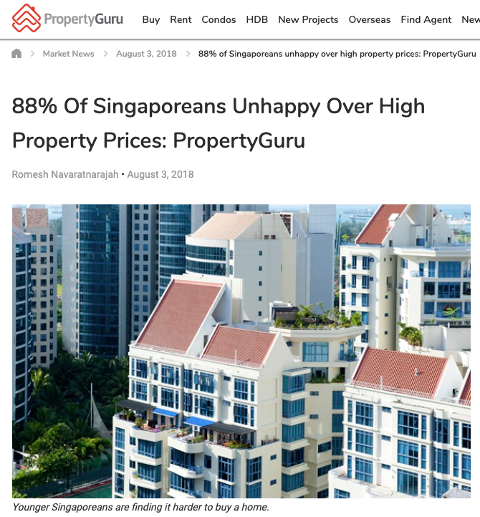
Problem Background
In recent years, 88% of Singaporeans, especially millennials, have expressed unhappiness over rising housing prices in Singapore. 69% of millennials aged 21-37 surveyed revealed that they face difficulty in creating a structured savings plan to fund their housing purchase due to them not being able to have a rough gauge of housing prices [ 1 ].
Figure 1: Screenshot of the article by Property Guru [1]

Slide 3
Problem statement
As 80% of Singaporeans stay in HDB flats [2], using data mining techniques, we aim to find out what are the key features affecting HDB resale prices and use them to predict HDB resale prices with machine learning models.
Notes:
Split background and statement?
We aim to help Singaporeans predict future housing prices through performing regression analysis on housing data from 2015 - 2020. Future housing prices would be predicted based on data such as location, lease and presence of amenities.

Slide 4



Motivation
Lack of insight
Most Singaporean millennials, as quoted by the PropertyGuru article [1], such as ourselves, are burdened with the task of having to save up for our future house without the knowledge or insight of how much our future house would cost. This is turn, affects our early financial planning, and is both time and effort costly.
Hence, it is of utmost importance for us to be concerned about housing prices, and the factor(s) that contributes to the increase of housing prices needs to be determined.
Impacts financial planning
Timely & Costly

Slide 5
Literature Review
Data analysis housing prices is relatively popular project in the data science community. Existing literature on the topic:
“Predicting the prices of HDB flats in SG” by Zhi Liang, Chen [3]
“Comprehensive Data Exploration with Python” by Pedro Marcelino [4]
“Singapore Flat Price Predictor” by Sie Huai, Gan [5]
Summary of Literature Review in next few slides →

Slide 6
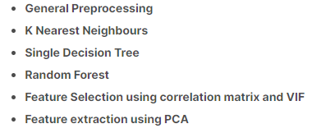
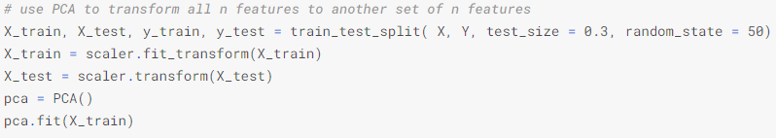
Summary of Literature Review
Predicting the prices of HDB flats in SG
This literature is predicting the price per square feet of housing flats in Singapore
Dataset used is from 2017, containing different housing flat variables from our dataset
Author first applies EDA on the dataset to “clean” it, before applying 3 different types of ML algorithms, namely Random Forest, Single Decision Tree and K Nearest Neighbours.
Author makes use of feature selection and feature extraction methods (Correlation matrix/VIF)
Notes that we should always transform the test data using PCA fitted from training data
Setting the variance threshold to 90%, he found that he needed 7 features to reach the 90% threshold, he then used feature extraction to create additional features uncorrelated to each other in order to reach the 90% threshold.
Figure 2: Screenshot of how the author transforms the test data using PCA
Figure 3: Summary of steps author used
Notes:
Specify examples

Slide 7
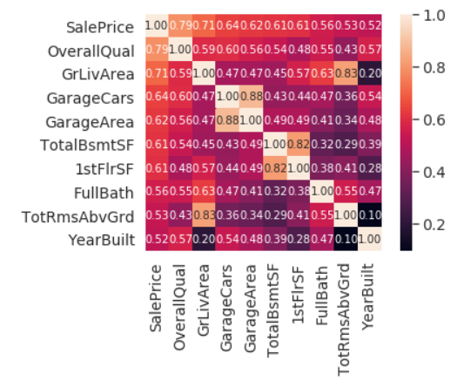
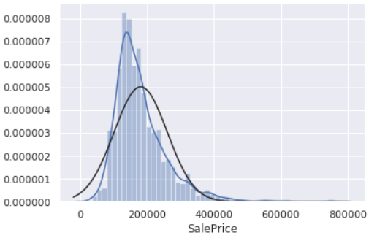
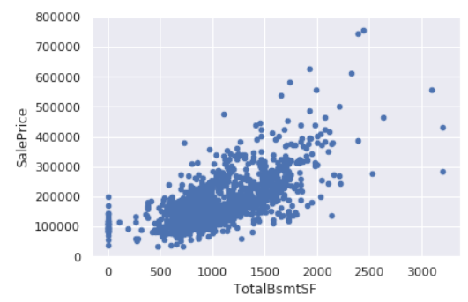
Summary of Literature Review
Comprehensive Data Exploration with Python
This literature is uses the data provided from Kaggle’s “House Prices: Advanced Regression Techniques” competition
Author does not go into machine learning, but aims to find insights through basic EDA and visualization.
Dataset was not as “clean” as ours, and focused on data cleaning, standardization and transformation.
Warns that drawing conclusions from bivariate analysis is dangerous (Simpson paradox).
Univariate | Bivariate
Histogram | Scatterplot
Probability Plot | Boxplot
Distplot | Heatmaps
Figure 4: Screenshot of Heatmap
Figure 5: Screenshot of Distplot
Figure 6: Screenshot of Scatter Plot

Slide 8
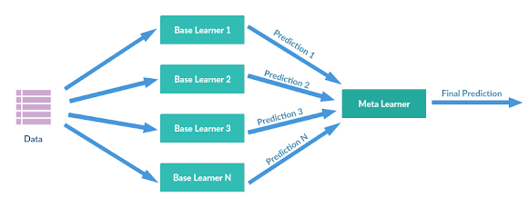

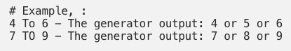
Summary of Literature review
Singapore Flat Price Predictor
Author has also built a HDB Resale Flat Price predictor using Machine Learning.
However, author used older HDB resale data (from 2012 to 2014) to train his model.
Besides just using the features in the dataset, he has also created these features:
Region: The region the HDB flat is located at in SG (ie. North, South, etc…)
No. of rooms and toilet: The number of rooms and toilets in the HDB flat
Storey: The storey level of the HDB flat, generated randomly from the initial categorical variable (eg. “4 to 6” --> 4 or 5 or 6)
Sales year & month: Breaking the initial categorical variable to 2 seperate columns of numerical variables. (eg. “2018-4” --> “2018” and “4”,
Author used an Ensemble learning method called Stacking to combine 4 learners (ie. elasticnet, svm, lasso & gradient boosting).
Figure 7: Screenshot of Features Engineering from author’s website
Figure 8: Screenshot of how Stacking works from author’s website

Slide 9
What needs to be done?
Albeit the similar models created by others, we want to take this project a step further and bring onto the table factors such as proximity to nearby amenities (Schools, MRT, Malls) which our price predictions will take into account.
We also aim to experiment with various machine learning models to predict HDB resale prices, evaluate the results of said models, and finally choose a model that produces the best results. - Possible evaluation metrics: RMSE, R², adjusted R²

Slide 10
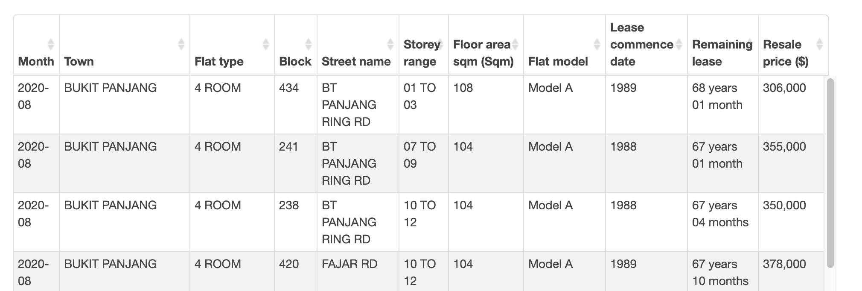
Dataset
Dataset used: Resale Flat Prices (Based on Registration Date), From Jan 2015 onwards
Taken from: Data.Gov [6]
Dataset File | No of Rows
from-jan-2017-onwards | 75,473
from-jan-2015-to-dec-2016 | 37,153
Total | 112,626
Figure 9 : Dataset with different variables on Resale Flat Prices. From Jan 2015 onwards

Slide 11
Dataset
Numerical Variable | Categorical Variable
lease_commence_date | Month, year
remaining_lease | town
resale_price | flat_type
floor_area_sqm | block
 | street_name
 | storey_range
 | flat_model

Slide 12
Tools & Resources
Tools & Resources
OneMap API: Get longitude & latitude of addresses/schools/malls/MRT
Google Colab
Python libraries: Pandas, Matplotlib, GeoPandas, Shapley, Seaborn, Scikit-Learn
Machine Learning Technologies
Possible Machine Learning Algorithms to experiment with:
Multi-linear Regression
Tree-based Regressors
Ensemble Learning (eg. Bagging, Boosting, Stacking, Voting)
Notes:
(

Slide 13
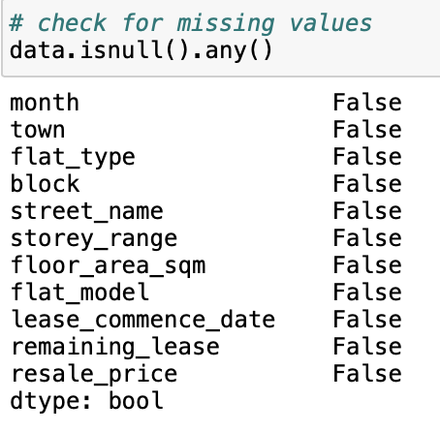
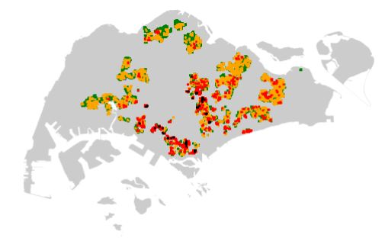
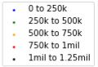
Exploratory Data Analysis
Check for Missing Values
Resale Price Geographical Visualization
Figure 10: Checking for missing/null values
Figure 11: Frequency to bins of resale_price
No missing values throughout any attributes
Dataset is relatively “cleaned” as sourced from Data.gov
Few houses from 750k to 1.25million found in the north and west regions
Most expensive houses are resold in the south & central area.

Slide 14
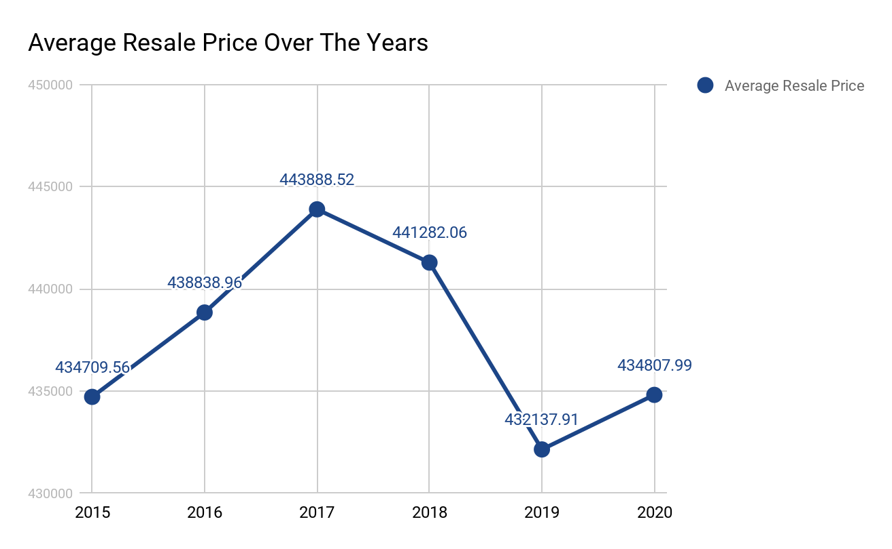
Exploratory Data Analysis
Year | Number of Records | Average of resale_price
2015 | 17,780 | 434,709.56
2016 | 19,373 | 438,838.96
2017 | 20,509 | 443,888.52
2018 | 21,561 | 441,282.06
2019 | 22,186 | 432,137.91
2020 | 11,217 | 434,807.99
Cooling measures [7]
Figure 12: Average Resale Price Over The Years
Notes:
Include cooling measures

Slide 15

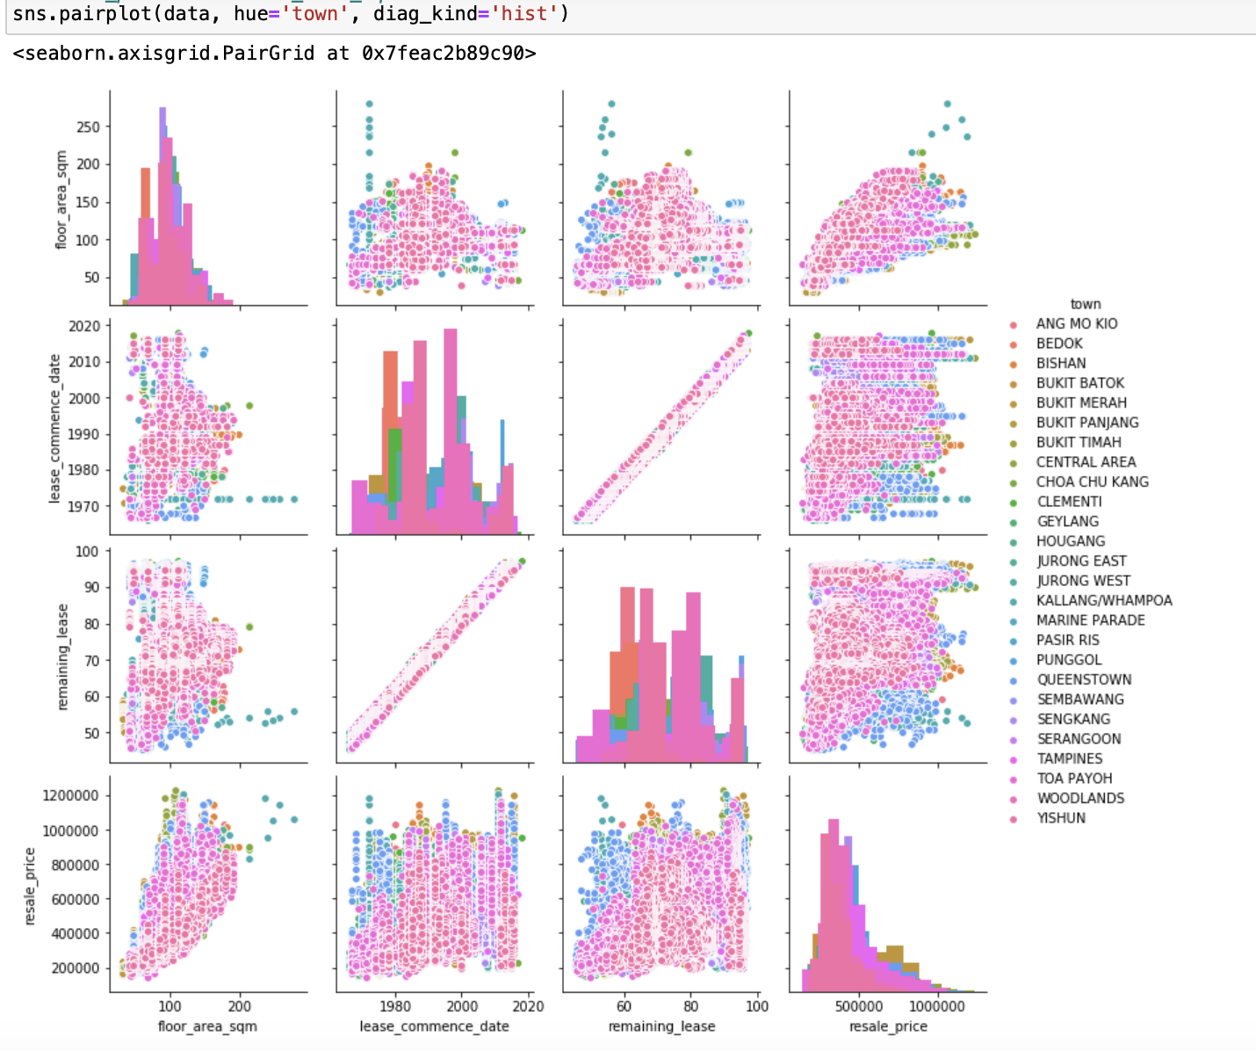
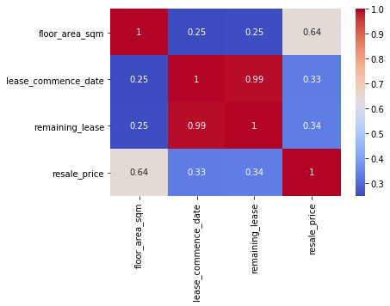
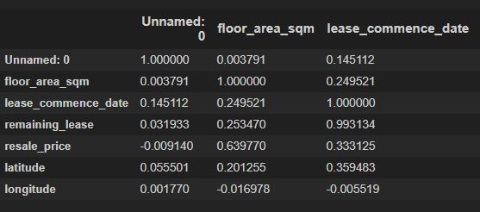
Exploratory Data Analysis
Check for multicollinearity
This is especially important as most regression usually carries the assumption that independent variables are independent from one another.
Note that resale_price has a strong linear relationship with floor_area_sqm
Most of the independent variables are unrelated.
Lease_commence_date and remaining_lease has a very strong linear correlation.
This suggests they hold the same amount of information, and we can drop one of them later on.
Figure 13: Pairplot visualisation of dataset
Figure 14: Heatmap of dataset correlation
Figure 15: Correlation Table between variables

Slide 16
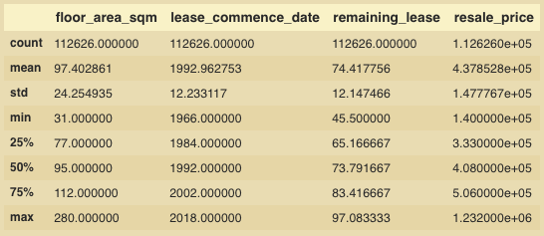
Exploratory Data Analysis
Descriptive analysis of quantitative data
Figure 16: Descriptive analysis of quantitative data
Notes:
Mean of values for resale price is extremely high compared to the mean of the other features

Slide 17
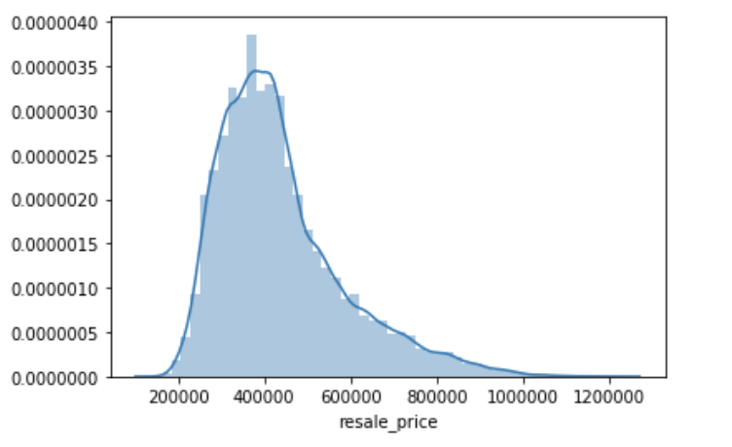
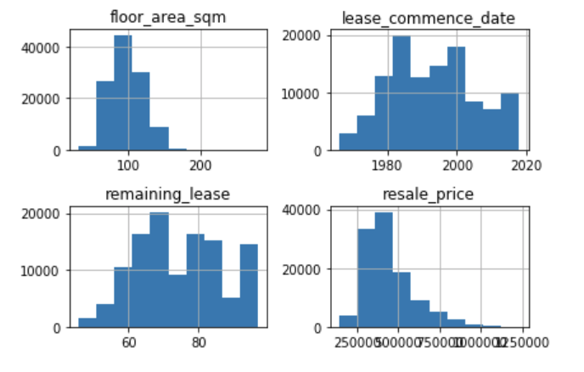
Exploratory Data Analysis
Histogram of resale price
Check for skewness
Figure 17: Histogram of Resale Price of HDB resale flats
Figure 18: Histogram of numerical variables against resale price
Numerical variables are either right skewed or normally distributed.
The range of values throughout these variables are high.
Mode of resale_price lies around SGD $400 000.
Resale prices are right skewed.
Notes:
Add a multiple boxplot to show the varying range of values

Slide 18
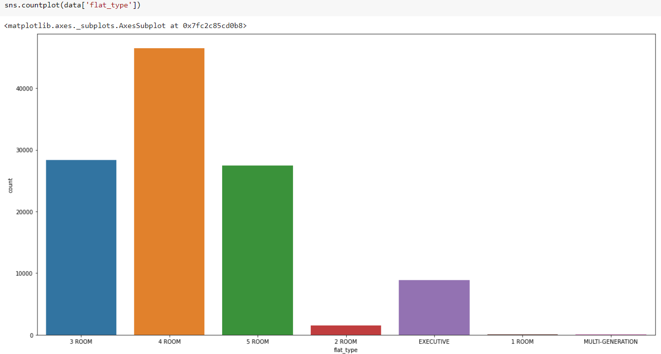
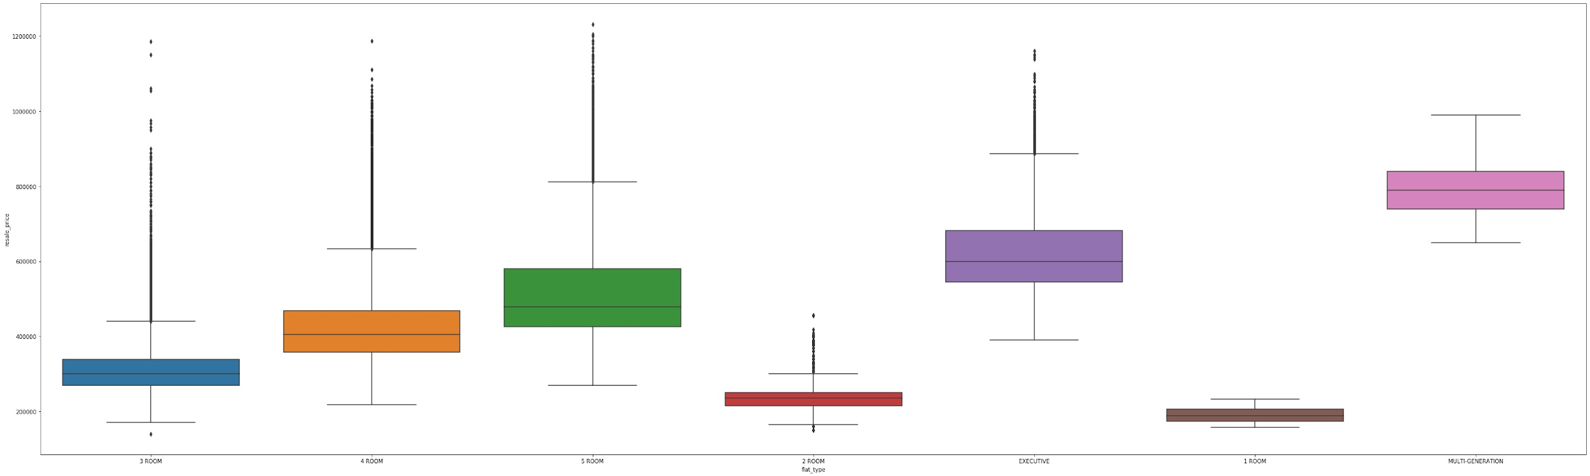
Exploratory Data Analysis
Frequency bar chart of flat_type
Box plot of flat_type to resale_price
Figure 19: Bar chart based on Flat Type
Figure 20: Box Plot of Flat Type to Resale Price
4 room flat types are most commonly resold, followed by 3 room flats, are 5 room flats closely.
Multi-generation houses are resold at the highest price according to median.
This is followed by Executive, 5 room, 4 room, 3 room, 2 room and 1 room. This makes sense as larger houses typically gets sold for higher prices.

Slide 19
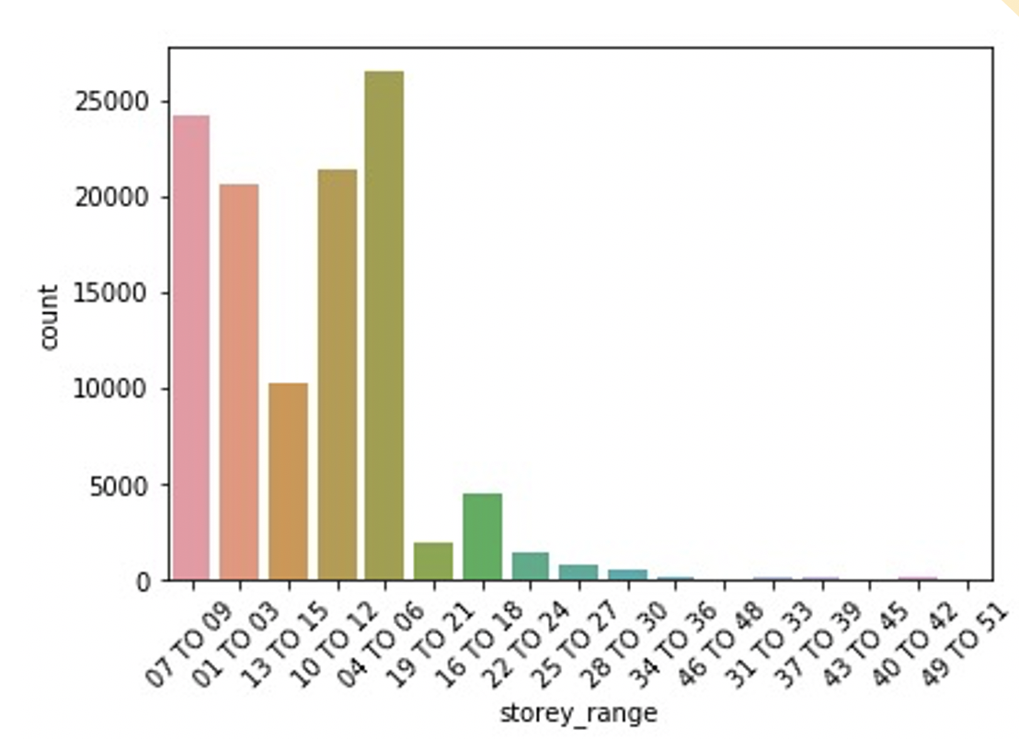
Exploratory Data Analysis
Frequency bar chart of storey_range
Figure 21: Bar chart based on storey_range

Slide 20
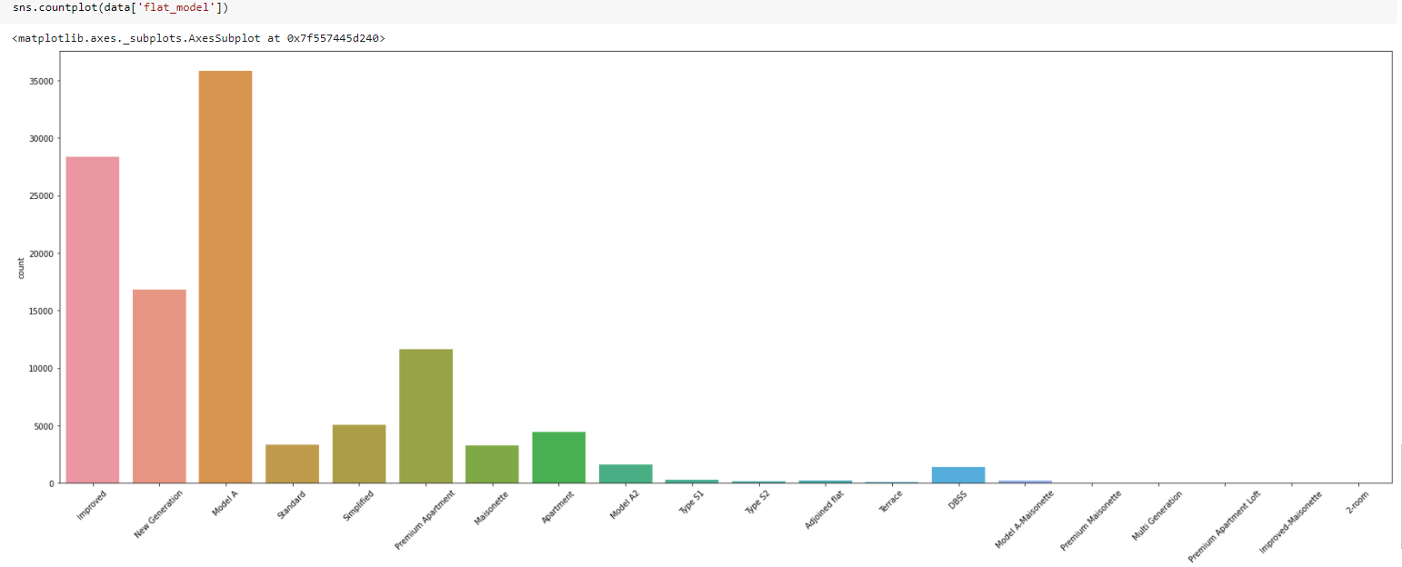
Exploratory Data Analysis
Frequency bar chart of flat_model
Figure 22: Bar chart on Flat Model
Notes:
Highest frequency count: Model A Apartment, Improved, New Generation and Premium Apartment

Slide 21
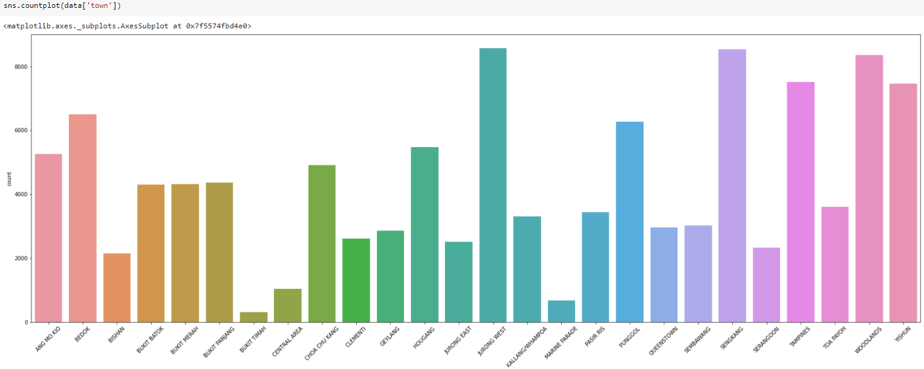
Exploratory Data Analysis
Frequency bar chart of Town
Figure 23: Bar chart of frequency of resale flats to town.
Notes:
Highest frequency count: Jurong West, Seng kang, Woodlands, Tampines and Yishun

Slide 22
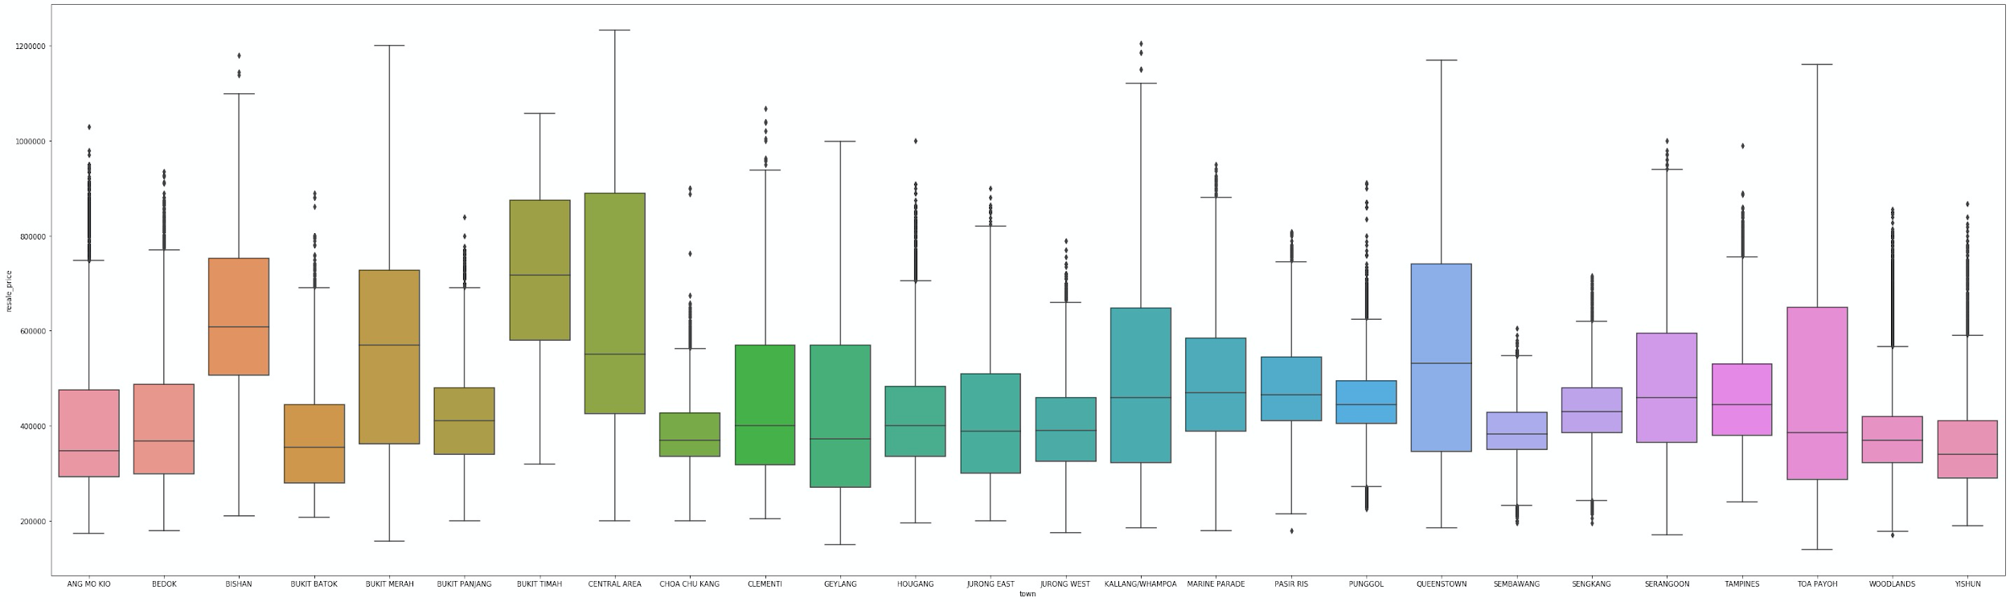
Exploratory Data Analysis
Boxplot of resale_prices (y) by town (x)
Figure 24: Boxplot of resale_prices (y) by the town the resale flat is located in (x), to compare resale prices amongst different towns. As you can see, Bukit Timah and Central Area are the more expensive areas.
Notes:
As you can see, Bukit Timah and Central Area are the more expensive

Slide 23
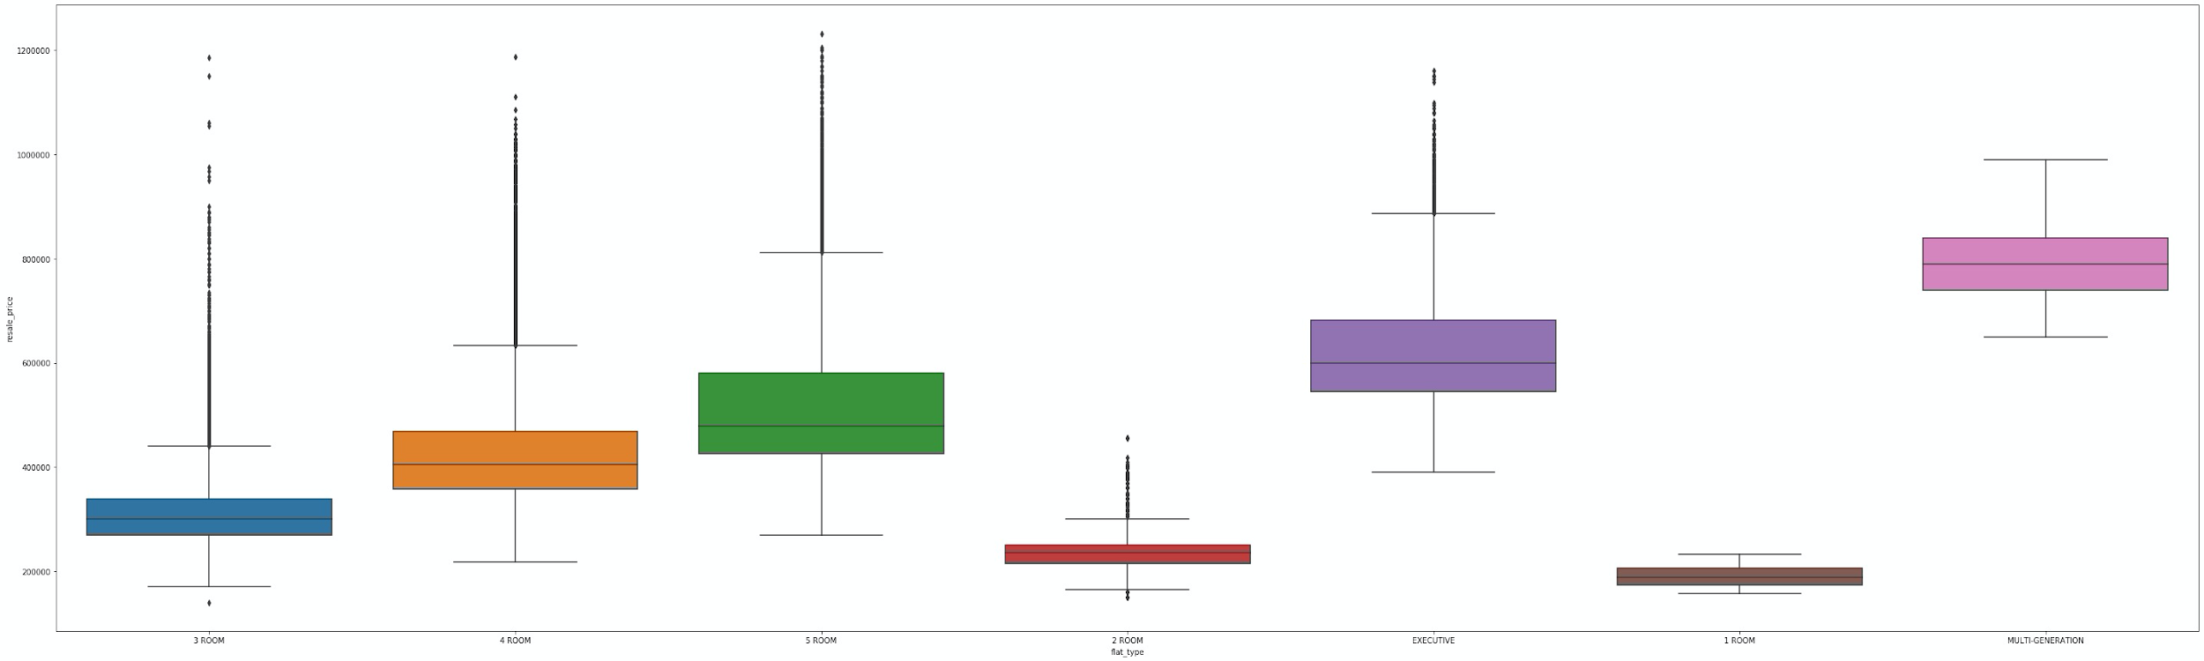
Exploratory Data Analysis
Boxplot of resale_prices (y) by flat_type (x)
Figure 25: Boxplot of resale_prices (y) by the flat_type (x), to compare resale prices amongst different types of flats. As you can see, Multi-Generation and Executive flats are the more expensive types of flats.

Slide 24
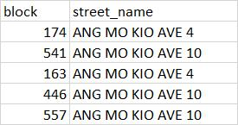
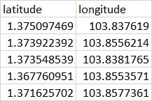
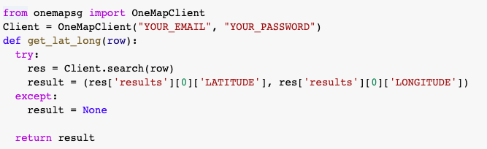

Data Pre-processing
(Retrieval of latitude and longitude )
BEFORE
AFTER
from-jan-2015-onward.csv
from-jan-2015-onward.csv
Figure 26: Data from before to after conversion of addresses
Figure 27: Code to convert addresses to latitude and longitude

Slide 25
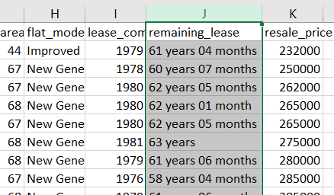
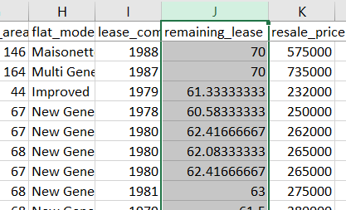
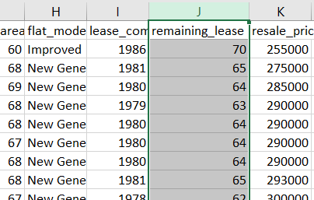
Data Pre-processing
BEFORE
AFTER
Applied “Years + months/12” formula to convert it into a numerical variable in terms of year
from-jan-2017-onwards.csv
from-jan-2015-onwards.csv
from-jan-2015-to-dec-2016.csv
Figure 28: Data from before to after conversion of remaining lease

Slide 26
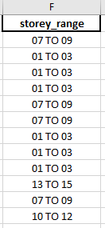
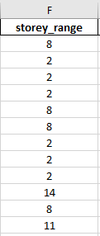
Data Pre-processing
BEFORE
AFTER
Convert categorical to numerical (label encoding)
from-jan-2015-onward.csv
from-jan-2015-onward.csv
Figure 29: Data from before to after conversion of storey range
Notes:
From-jan-2015-onward
Flat type
Flat model
town

Slide 27
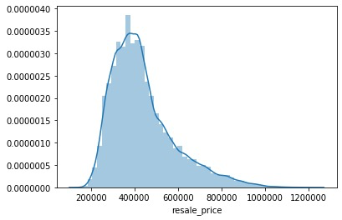
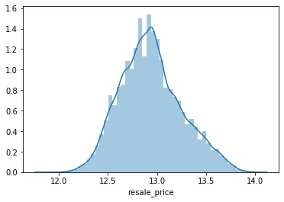
Data Pre-processing
BEFORE
AFTER
Log transformation
Figure 30: Histogram of resale_price before and after log transformation
Notes:
Check whether to include

Slide 28
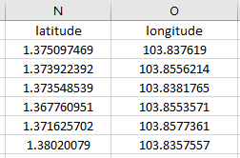
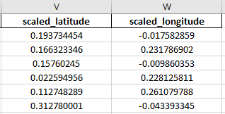
Data Pre-processing
BEFORE
AFTER
Scaling of data
using StandardScalar()
from-jan-2015-onward.csv
from-jan-2015-onward.csv
Figure 31: Data from before to after conversion of latitude and longitude

Slide 29
Next Steps
Get latitude and longitude
of nearby amenities
Calculate distance from amenities
Evaluation of models
Get list of nearby amenities (malls, schools etc)
Use OneMap API to get latitude and longitude of these amenities
Map distance of various amenities to individual resale flats
Begin developing Machine Learning models
Evaluate models
Iterate through models to improve model prediction
Notes:
from-jan-2015-onward

Slide 30
Preliminary results & evaluation ( preliminary results and idea on how to perform project)
Project Scope:
No missing values in the dataset. → done
Converting categorical to numerical data (label encoding) → done
Conduct normalization on data → done
Conduct transformation of data (e.g remaining_lease: from years to months) → done
Check independent variables for multicollinearity - linear regression assumption → done
Metric for model evaluation ##todo
Dimensionality Reduction: Which feature is relevant/irrelevant, remove those that are not → done
Find how house prices is affected by proximities of nearby amenities ##Dont need yet
Bunch of visualizations number of resale geographically, filter by type etc → Done

Slide 31
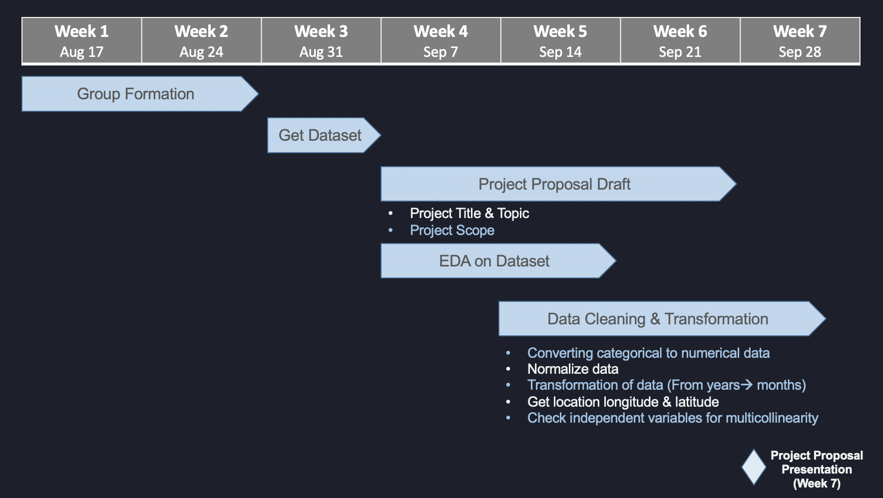

Project Schedule

Slide 32
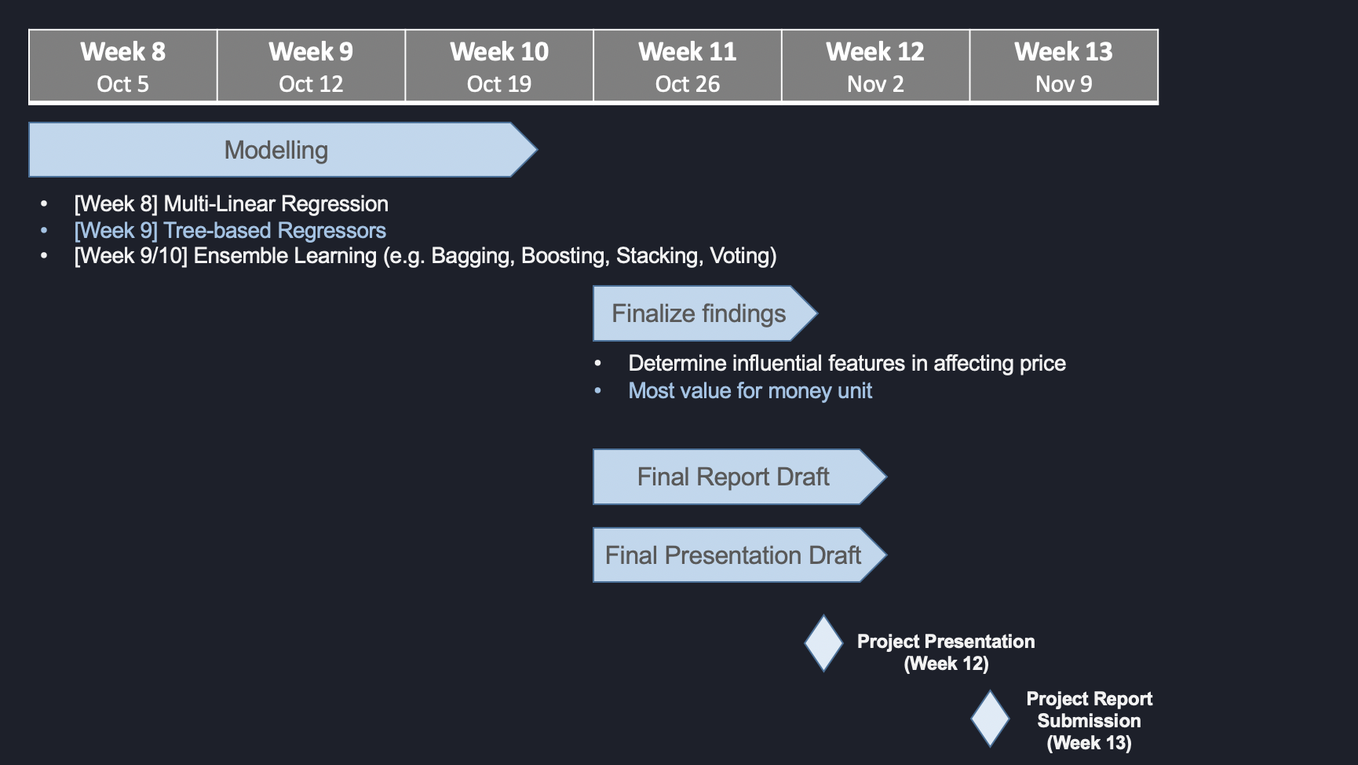
Project Schedule

Slide 33
Reference
[1] R. Navaratnarajah, “88% Of Singaporeans Unhappy Over High Property Prices: PropertyGuru,” 3 8 2018. [Online]. Available: https://www.propertyguru.com.sg/property-management-news/2018/8/173701/88-of-singaporeans-unhappy-over-high-property-prices-propertyguru. [Accessed 28 9 2020].
[2] J. Muller, “Population living in public housing in Singapore 2010-2018 Published by J. Müller, Jan 14, 2020 This statistic shows the share of the resident population in Singapore living in public housing under the Housing and Development Board (HDB), from 2010 to 20,” 14 1 2020. [Online]. Available: https://www.statista.com/statistics/966747/population-living-in-public-housing-singapore/. [Accessed 28 9 2020].
[3] C. Z. Liang, “Predicting the prices of HDB flats in SG,” [Online]. Available: https://www.kaggle.com/chenzhiliang/predicting-the-prices-of-hdb-flats-in-sg . [Accessed 27 9 2020].
[4] P. Marcelino, “Comprehensive data exploration with Python,” 2 2017. [Online]. Available: https://www.kaggle.com/pmarcelino/comprehensive-data-exploration-with-python. [Accessed 27 9 2020].
[5] S. H. Gan, “Singapore Flat Price Predictor,” 3 6 2019. [Online]. Available: https://towardsdatascience.com/singapore-flat-price-predictor-6f74ed8da311. [Accessed 28 9 2020].
[6] Housing and Development Board, “Resale Flat Prices,” [Online]. Available: https://data.gov.sg/dataset/resale-flat-prices. [Accessed 29 9 2020].
[7] The Straits Time , “Property sentiment hit by cooling measures: Report,” [Online]. Available: https://www.straitstimes.com/business/property/property-sentiment-hit-by-cooling-measures-report. [Accessed 29 7 2020].

Slide 34
Thank You!

